Slide 1
Module 15: Network Structures
Background
Motivation
Topology
Network Types
Communication
Design Strategies

Slide 2
Node Types
Mainframes (IBM3090, etc.)
  example applications:
    airline reservations
    banking systems
  many large attached disks
Workstations (Sun, Apollo, Microvax, RISC6000, etc.)
  example applications:
    computer-aided design
    office-information systems
    private databases
  zero, one or two medium size disks

Slide 3
Nodes Types (Cont.)
Personal Computers
  example applications:
    office information systems
    small private databases
  zero or one small disk

Slide 4
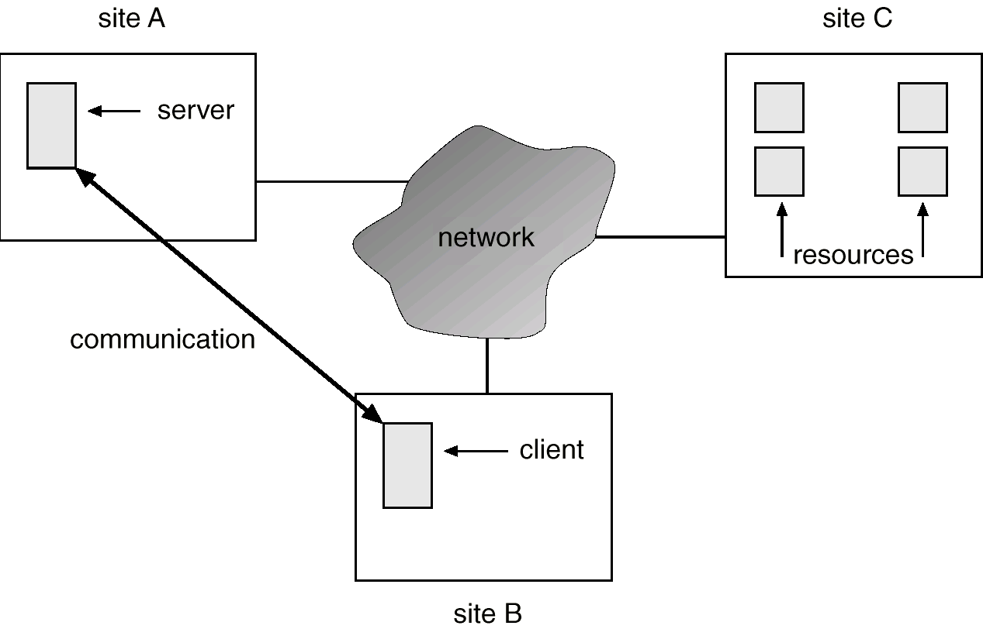
A Distributed System

Slide 5
Motivation
Resource sharing
  sharing and printing files at remote sites
  processing information in a distributed database
  using remote specialized hardware devices
Computation speedup – load sharing
Reliability – detect and recover from site failure, function transfer, reintegrate failed site
Communication – message passing

Slide 6
Topology
Sites in the system can be physically connected in a variety of ways; they are compared with respect to the following criteria:
  Basic cost. How expensive is it to link the various sites in the system?
  Communication cost. How long does it take to send a message from site A to site B?
  Reliability. If a link or a site in the system fails, can the remaining sites still communicate with each other?
The various topologies are depicted as graphs whose nodes correspond to sites. An edge from node A to node B corresponds to a direct connection between the two sites.
The following six items depict various network topologies.

Slide 7
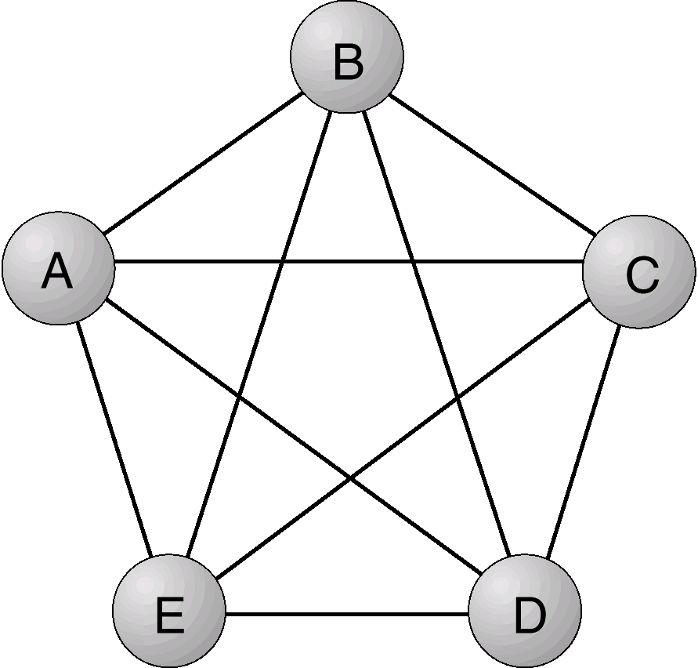
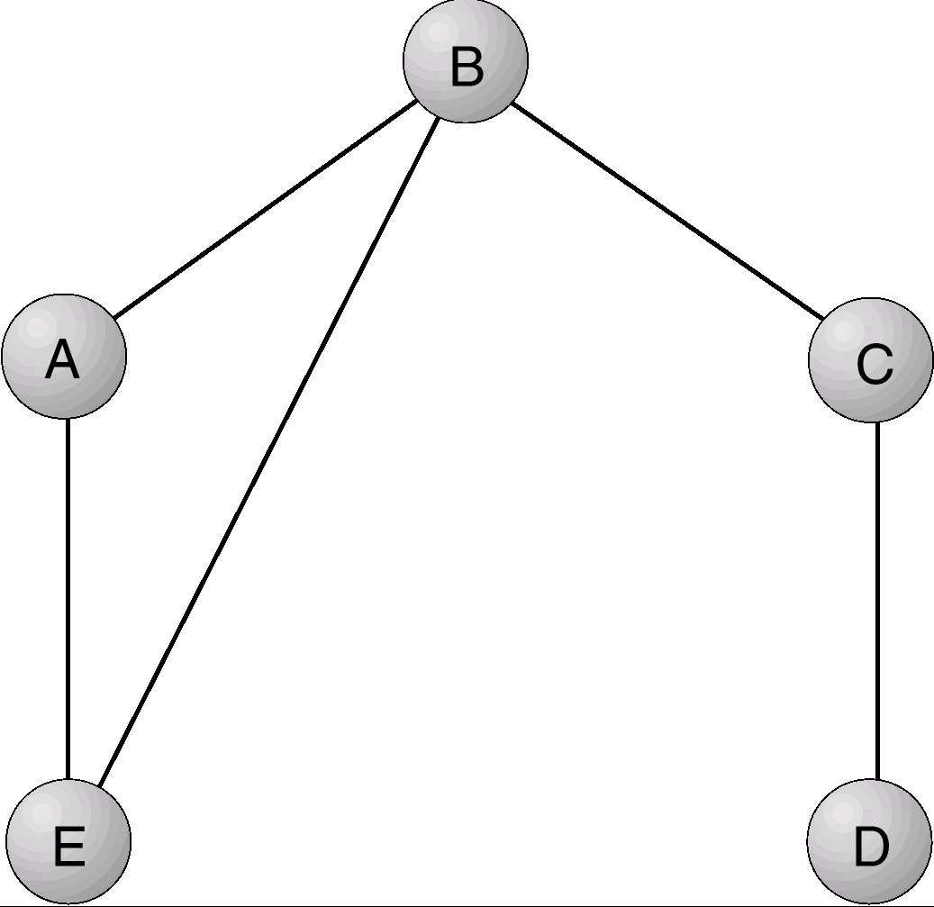
Fully connected network
Partially connected network

Slide 8
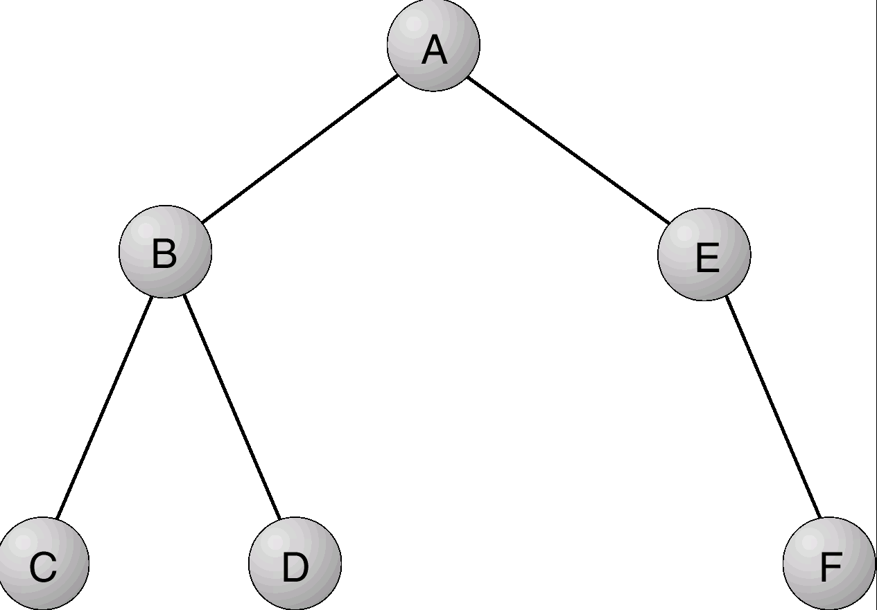
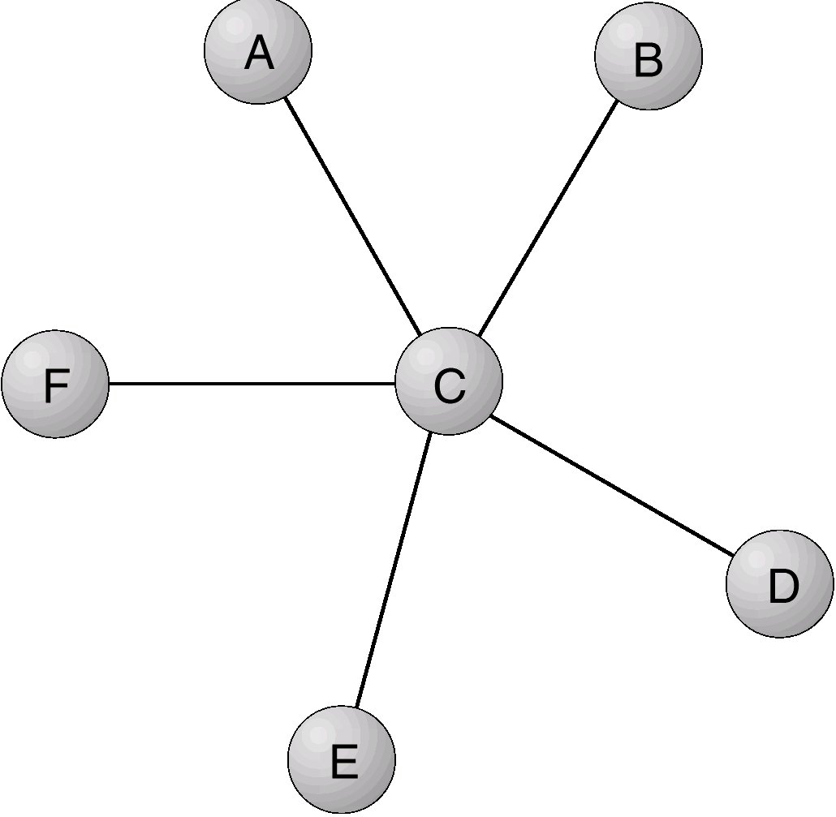
Tree-structured network
Star network

Slide 9
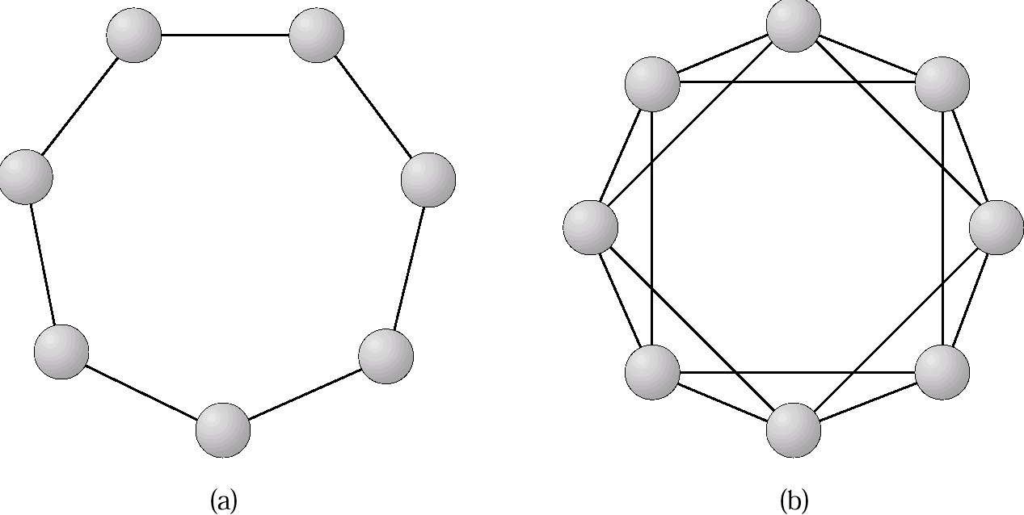
Ring networks: (a) Single links. (b) Double links

Slide 10
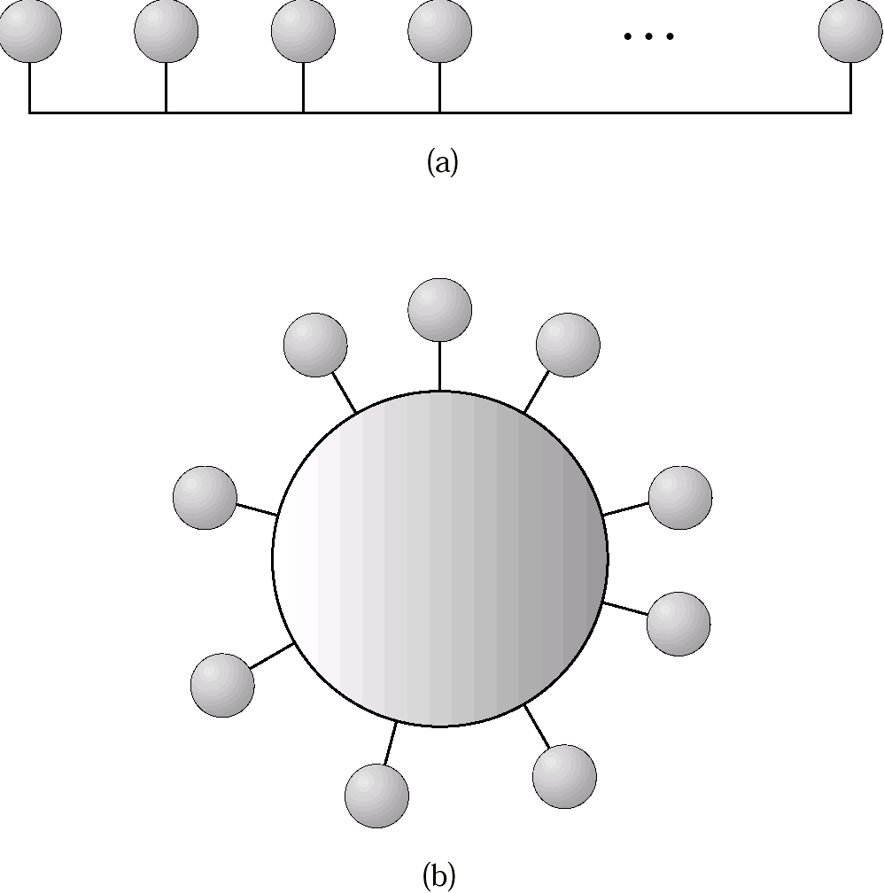
Bus network: (a) Linear bus. (b) Ring bus.

Slide 11
Network Types
:Local-Area Network (LAN) – designed to cover small geographical area.
  Multiaccess bus, ring, or star network.
  Speed ≈ 10 megabits/second, or higher.
  Broadcast is fast and cheap.
  Nodes:
    usually workstations and/or personal computers
    a few (usually one or two) mainframes.

Slide 12
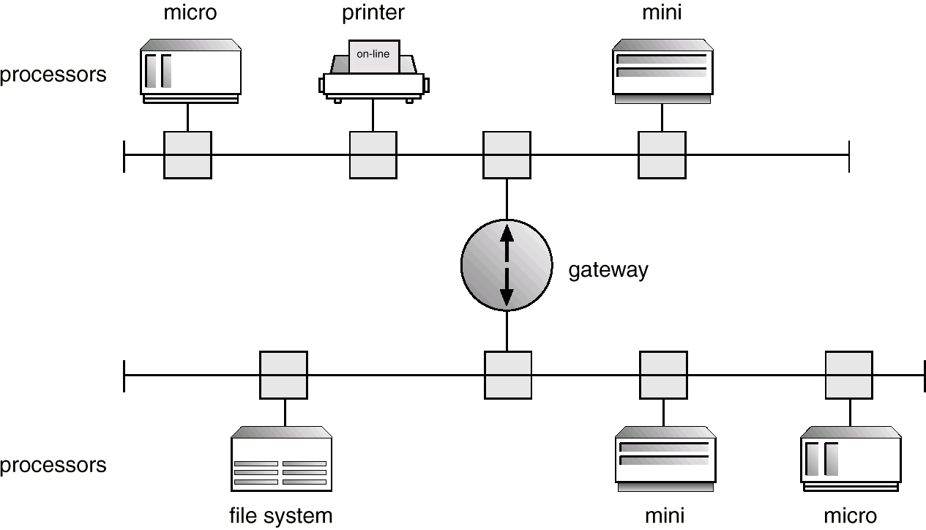
Network Types (Cont.)
Depiction of typical LAN:

Slide 13
Network Types (Cont.)
Wide-Area Network (WAN) – links geographically separated sites.
  Point-to-point connections over long-haul lines (often leased from a phone company).
  Speed ≈ 100 kilobits/second.
  Broadcast usually requires multiple messages.
  Nodes:
    usually a high percentage of mainframes

Slide 14
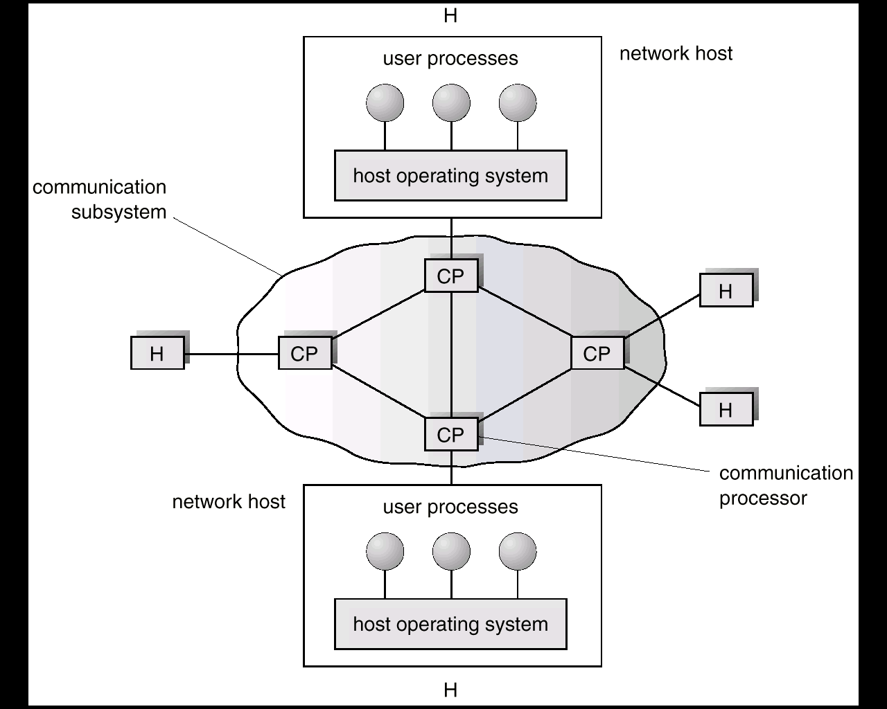
Communication Processors in a Wide-Area Network

Slide 15
Communication
The design of a communication network must address four basic
issues:
Naming and name resolution: How do two processes locate each other to communicate?
Routing strategies. How are messages sent through the network?
Connection strategies. How do two processes send a sequence of messages?
Contention. The network is a shared resource, so how do we resolve conflicting demands for its use?

Slide 16
Naming and Name Resolution
Name systems in the network
Address messages with the process-id.
Identify processes on remote systems by
      <host-name, identifier> pair.
Domain name service (DNS) – specifies the naming structure of the hosts, as well as name to address resolution (Internet).

Slide 17
Routing Strategies
Fixed routing. A path from A to B is specified in advance; path changes only if a hardware failure disables it.
  Since the shortest path is usually chosen, communication costs are minimized.
  Fixed routing cannot adapt to load changes.
  Ensures that messages will be delivered in the order in which they were sent.
Virtual circuit. A path from A to B is fixed for the duration of one session. Different sessions involving messages from A to B may have different paths.
  Partial remedy to adapting to load changes.
  Ensures that messages will be delivered in the order in which they were sent.

Slide 18
Routing Strategies (Cont.)
Dynamic routing. The path used to send a message form site A to site B is chosen only when a message is sent.
  Usually a site sends a message to another site on the link least used at that particular time.
  Adapts to load changes by avoiding routing messages on heavily used path.
  Messages may arrive out of order. This problem can be remedied by appending a sequence number to each message.

Slide 19
Connection Strategies
Circuit switching. A permanent physical link is established for the duration of the communication (i.e., telephone system).
Message switching. A temporary link is established for the duration of one message transfer (i.e., post-office mailing system).
Packet switching. Messages of variable length are divided into fixed-length packets which are sent to the destination. Each packet may take a different path through the network. The packets must be reassembled into messages as they arrive.
Circuit switching requires setup time, but incurs less overhead for shipping each message, and may waste network bandwidth. Message and packet switching require less setup time, but incur more overhead per message.

Slide 20
Contention
Several sites may want to transmit information over a link
simultaneously. Techniques to avoid repeated collisions include:
CSMA/CD. Carrier sense with multiple access (CSMA); collision detection (CD)
  A site determines whether another message is currently being transmitted over that link. If two or more sites begin transmitting at exactly the same time, then they will register a CD and will stop transmitting.
  When the system is very busy, many collisions may occur, and thus performance may be degraded.
SCMA/CD is used successfully in the Ethernet system, the most common network system.

Slide 21
Contention (Cont.)
Token passing. A unique message type, known as a token, continuously circulates in the system (usually a ring structure). A site that wants to transmit information must wait until the token arrives. When the site completes its round of message passing, it retransmits the token. A token-passing scheme is used by the IBM and Apollo systems.
Message slots. A number of fixed-length message slots continuously circulate in the system (usually a ring structure). Since a slot can contain only fixed-sized messages, a single logical message may have to be broken down into a number of smaller packets, each of which is sent in a separate slot. This scheme has been adopted in the experimental Cambridge Digital Communication Ring

Slide 22
Design Strategies
The communication network is partitioned into the following
multiple layers;
Physical layer – handles the mechanical and electrical details of the physical transmission of a bit stream.
Data-link layer – handles the frames, or fixed-length parts of packets, including any error detection and recovery that occurred in the physical layer.
Network layer – provides connections and routes packets in the communication network, including handling the address of outgoing packets, decoding the address of incoming packets, and maintaining routing information for proper response to changing load levels.

Slide 23
Design Strategies (Cont.)
Transport layer – responsible for low-level network access and for message transfer between clients, including partitioning messages into packets, maintaining packet order, controlling flow, and generating physical addresses.
Session layer – implements sessions, or process-to-process communications protocols.
Presentation layer – resolves the differences in formats among the various sites in the network, including character conversions, and half duplex/full duplex (echoing).
Application layer – interacts directly with the users’ deals with file transfer, remote-login protocols and electronic mail, as well as schemas for distributed databases.

Slide 24
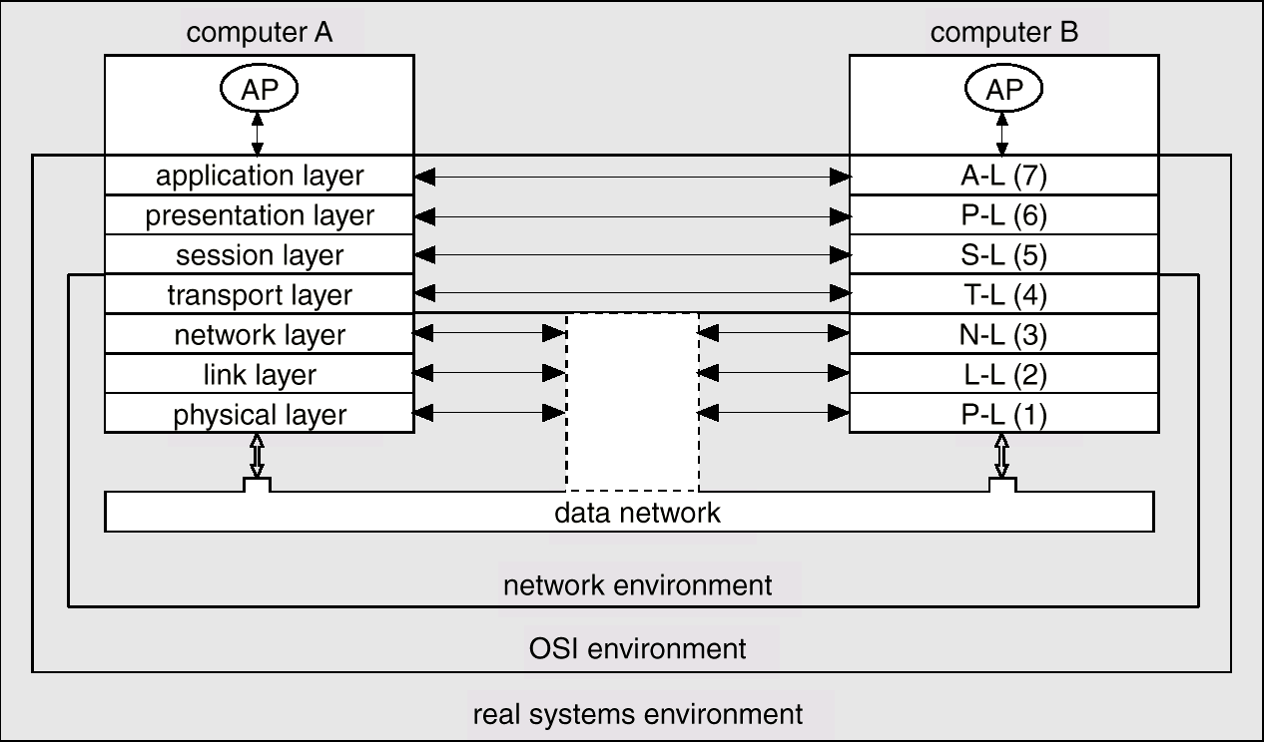
Two Computers Communicating Via ISO Network Model

Slide 25
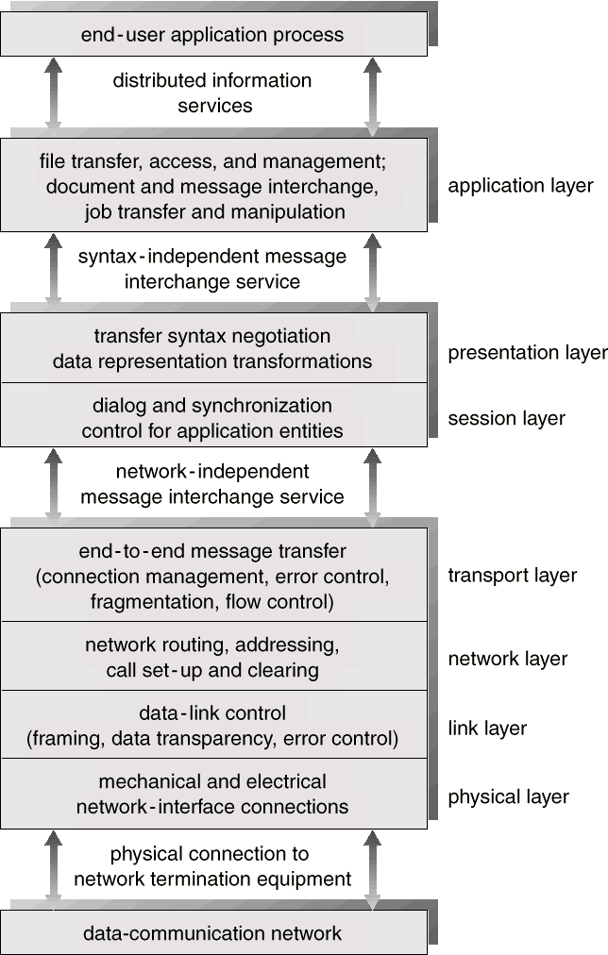
The ISO Protocol Layer

Slide 26
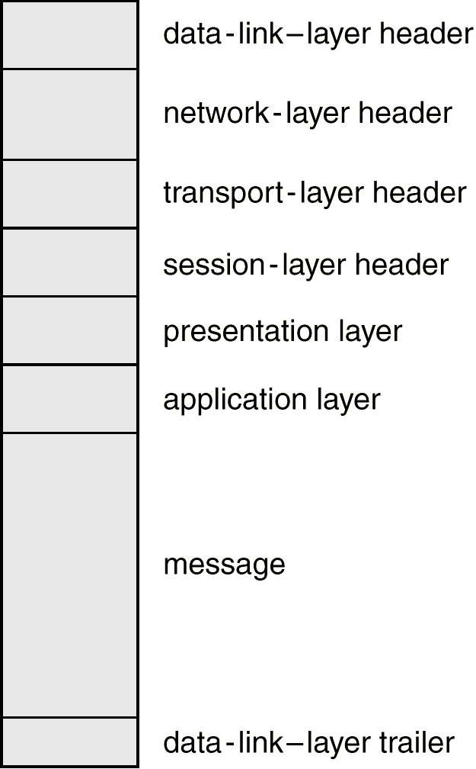
The ISO Network Message

Slide 27
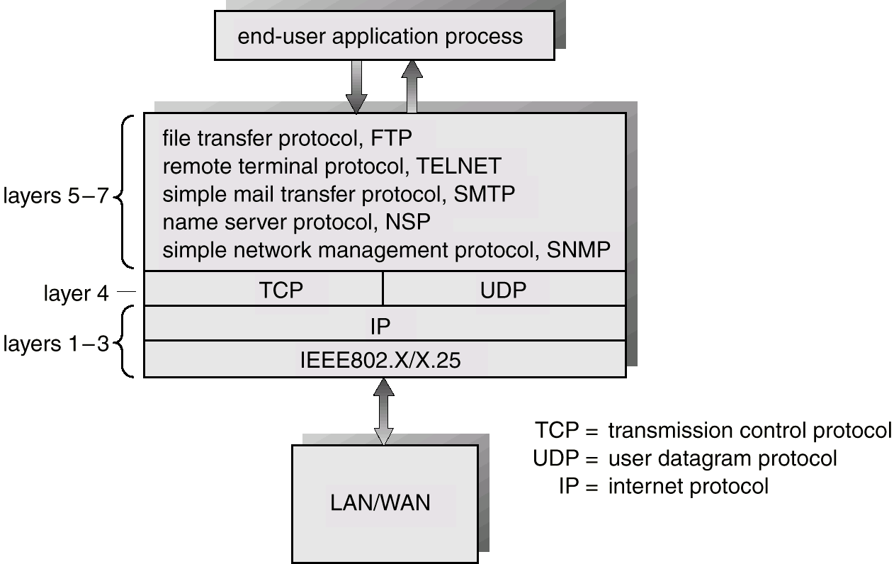
The TCP/IP Protocol Layers

Slide 28
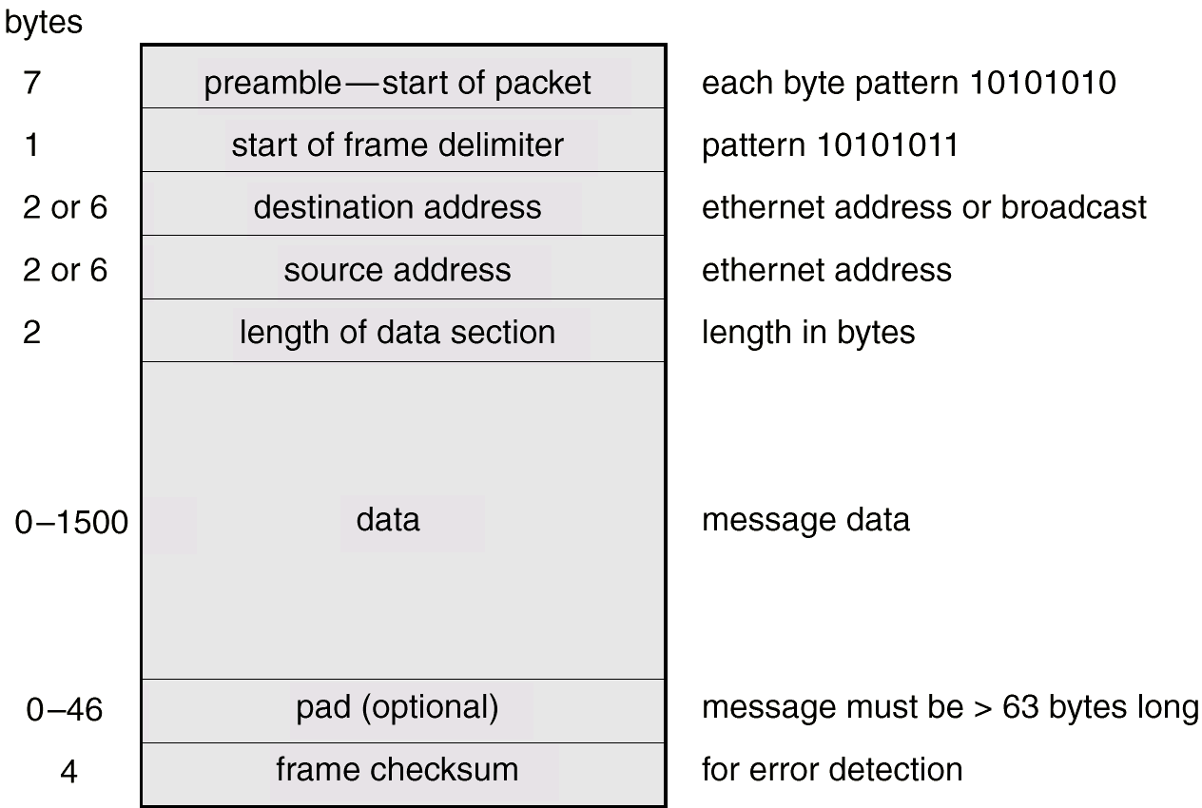
An Ethernet Packet

